Slide 1




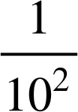

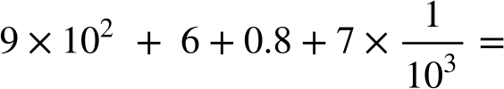

Place value in decimals
Task A: Exponential and fractional forms for decimals
Fill in the gaps so that each column shows a different way of writing the same value.
In fractional form
In decimal form
In exponent form
In words | one tenth | one hundredth | one thousandth | One ten thousandth
1
1
10
1000
0.1
0.0001
1
1
1
10
10³
10⁴
2) Write the following in decimal form:
a)
b)
c)
d)
2304.9
2000 + 300 + 4 + 0.9
8004.72
8000 + 4 + 0.7 + 0.02
906.807
900 + 6 + 0.8 + 0.007
2040.409
2000 + 40 + 0.003 + 0.4 + 0.006
‹#›

Slide 2
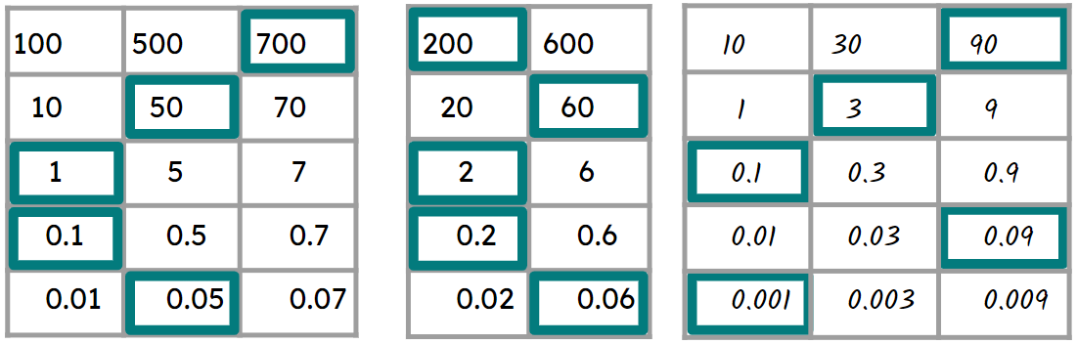
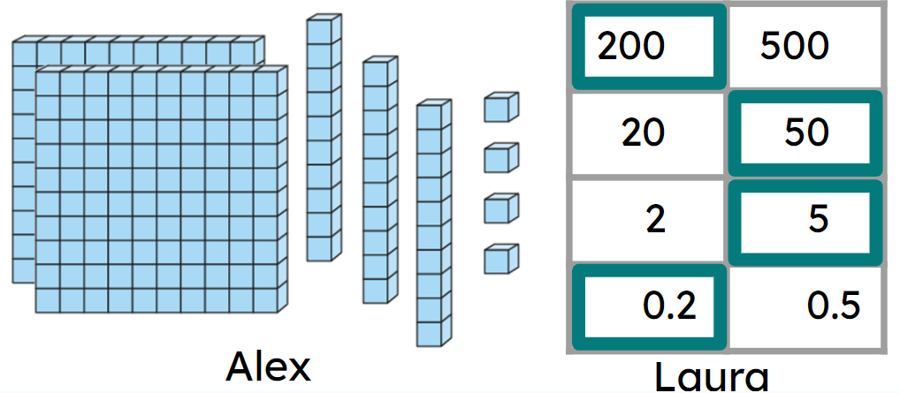
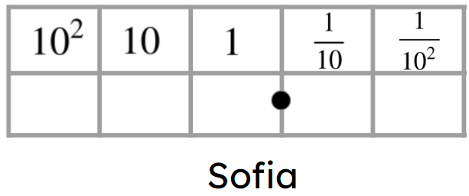
Place value in decimals
Task B: Different representations of decimals
Complete the charts to make the decimals.
751.15
262.26
93.191
2) Three students have different numbers.
Insert all the digits 6, 5, 4 and 2 into Sofia’s place value chart to make:
a) a decimal greater than Laura’s.
Example answers- 654.2 256.4 645.2
b) a decimal less than Alex’s.
Example answers- 54.26 26.45 64.25
c) a decimal in between Alex’s number and Laura’s number.
Only two answers- 254.6 and 245.6
Try to find more than one answer for each.
Mathematics in Education and Industry
‹#›
v2.2
v2.1

